Slide 1
Chapter 8
Statement-Level
Control Structures

Slide 2
Control Structure
A control structure is a control statement and the statements whose execution it controls
Design question
  Should a control structure have multiple entries?
Copyright © 2017 Pearson Education, Ltd. All rights reserved.
1-<number>

Slide 3
Selection Statements
A selection statement provides the means of choosing between two or more paths of execution
Two general categories:
  Two-way selectors
  Multiple-way selectors
Copyright © 2017 Pearson Education, Ltd. All rights reserved.
1-<number>

Slide 4
Two-Way Selection Statements
General form:
if control_expression
then clause
else clause
Design Issues:
  What is the form and type of the control expression?
  How are the then and else clauses specified?
  How should the meaning of nested selectors be specified?
Copyright © 2017 Pearson Education, Ltd. All rights reserved.
1-<number>

Slide 5
The Control Expression
If the then reserved word or some other syntactic marker is not used to introduce the then clause, the control expression is placed in parentheses
In C89, C99, Python, and C++, the control expression can be arithmetic
In most other languages, the control expression must be Boolean
Copyright © 2017 Pearson Education, Ltd. All rights reserved.
1-<number>

Slide 6
Clause Form
In many contemporary languages, the then and else clauses can be single statements or compound statements
In Perl, all clauses must be delimited by braces (they must be compound)
In Python and Ruby, clauses are statement sequences
Python uses indentation to define clauses
if x > y :
x = y
print " x was greater than y"
Copyright © 2017 Pearson Education, Ltd. All rights reserved.
1-<number>

Slide 7
Nesting Selectors
Java example
  if (sum == 0)
if (count == 0)
result = 0;
else result = 1;
Which if gets the else?
Java's static semantics rule: else matches with the nearest previous if
Copyright © 2017 Pearson Education, Ltd. All rights reserved.
1-<number>

Slide 8
Nesting Selectors (continued)
To force an alternative semantics, compound statements may be used:
if (sum == 0) {
if (count == 0)
result = 0;
}
else result = 1;
The above solution is used in C, C++, and C#
Copyright © 2017 Pearson Education, Ltd. All rights reserved.
1-<number>

Slide 9
Nesting Selectors (continued)
Statement sequences as clauses: Ruby
if sum == 0 then
if count == 0 then
result = 0
else
result = 1
end
end
Copyright © 2017 Pearson Education, Ltd. All rights reserved.
1-<number>

Slide 10
Nesting Selectors (continued)
Python
if sum == 0 :
if count == 0 :
result = 0
else :
result = 1
Copyright © 2017 Pearson Education, Ltd. All rights reserved.
1-<number>

Slide 11
Selector Expressions
In ML, F#, and Lisp, the selector is an expression; in F#:
let y =
if x > 0 then x
else 2 * x
  - If the if expression returns a value, there must be an else clause (the expression could produce a unit type, which has no value). The types of the values returned by then and else clauses must be the same.
Copyright © 2017 Pearson Education, Ltd. All rights reserved.
1-<number>

Slide 12
Multiple-Way Selection Statements
Allow the selection of one of any number of statements or statement groups
Design Issues:
  What is the form and type of the control expression?
  How are the selectable segments specified?
  Is execution flow through the structure restricted to include just a single selectable segment?
  How are case values specified?
  What is done about unrepresented expression values?
Copyright © 2017 Pearson Education, Ltd. All rights reserved.
1-<number>

Slide 13
Multiple-Way Selection: Examples
C, C++, Java, and JavaScript
switch (expression) {
case const_expr₁: stmt₁;
…
case const_expr_{n}: stmt_{n};
[default: stmt_{n+1}]
}
Copyright © 2017 Pearson Education, Ltd. All rights reserved.
1-<number>

Slide 14
Multiple-Way Selection: Examples
Design choices for C’s switch statement
  Control expression can be only an integer type
  Selectable segments can be statement sequences, blocks, or compound statements
  Any number of segments can be executed in one execution of the construct (there is no implicit branch at the end of selectable segments)
    explicit branch→ BREAK!
  default clause is for unrepresented values (if there is no default, the whole statement does nothing)
Copyright © 2017 Pearson Education, Ltd. All rights reserved.
1-<number>

Slide 15

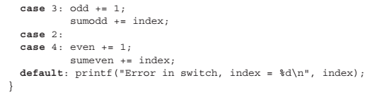
Multiple-Way Selection: Examples
This code prints the error message on every execution.
Copyright © 2017 Pearson Education, Ltd. All rights reserved.
1-<number>

Slide 16
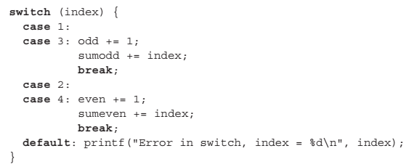
Multiple-Way Selection: Examples
switch statement uses break to restrict each execution to a single selectable segment
Copyright © 2017 Pearson Education, Ltd. All rights reserved.
1-<number>

Slide 17
Multiple-Way Selection Using if
Multiple Selectors can appear as direct extensions to two-way selectors, using else-if clauses, for example in Python:
  if count < 10 :
  bag1 = True
  elif count < 100 :
  bag2 = True
  elif count < 1000 :
  bag3 = True
Copyright © 2017 Pearson Education, Ltd. All rights reserved.
1-<number>

Slide 18
Multiple-Way Selection Using if
The Python example can be written as a Ruby case
case
when count < 10 then bag1 = true
when count < 100 then bag2 = true
when count < 1000 then bag3 = true
end
Copyright © 2017 Pearson Education, Ltd. All rights reserved.
1-<number>

Slide 19
Scheme’s Multiple Selector
General form of a call to COND:
(COND
(predicate₁ expression₁)
…
(predicate_{n} expression_{n})
[(ELSE expression_{n+1})]
)
  The ELSE clause is optional; ELSE is a synonym for true
  Each predicate-expression pair is a parameter
  - Semantics: The value of the evaluation of COND is the value of the expression associated with the first predicate expression that is true
1-<number>

Slide 20
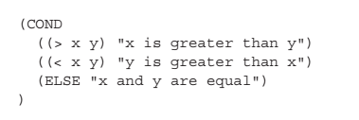
Scheme’s Multiple Selector
1-<number>

Slide 21
Iterative Statements
The repeated execution of a statement or compound statement is accomplished either by iteration or recursion
General design issues for iteration control statements:
  1. How is iteration controlled?
  2. Where is the control mechanism in the loop?
Copyright © 2017 Pearson Education, Ltd. All rights reserved.
1-<number>

Slide 22
Counter-Controlled Loops
A counting iterative statement has a loop variable, and a means of specifying the initial and terminal, and stepsize values
Design Issues:
  What are the type and scope of the loop variable?
  Should it be legal for the loop variable or loop parameters to be changed in the loop body, and if so, does the change affect loop control?
  Should the loop parameters be evaluated only once, or once for every iteration?
Copyright © 2017 Pearson Education, Ltd. All rights reserved.
1-<number>

Slide 23
Counter-Controlled Loops: Examples
C-based languages
  for ([expr_1] ; [expr_2] ; [expr_3]) statement
- The expressions can be whole statements, or even statement sequences, with the statements separated by commas
  The value of a multiple-statement expression is the value of the last statement in the expression
  If the second expression is absent, it is an infinite loop
Design choices:
  There is no explicit loop variable
  Everything can be changed in the loop
  The first expression is evaluated once, but the other two
  are evaluated with each iteration
  - It is legal to branch into the body of a for loop in C
Copyright © 2017 Pearson Education, Ltd. All rights reserved.
1-<number>

Slide 24
Counter-Controlled Loops: Examples
C++ differs from C in two ways:
  The control expression can also be Boolean
  The initial expression can include variable definitions (scope is from the definition to the end of the loop body)
Java and C#
  Differs from C++ in that the control expression must be Boolean
Copyright © 2017 Pearson Education, Ltd. All rights reserved.
1-<number>

Slide 25
Counter-Controlled Loops: Examples
Python
  for loop_variable in object:
  - loop body
  [else:
  - else clause]
  The object is often a range, which is either a list of values in brackets ([2, 4, 6]), or a call to the range function (range(5), which returns 0, 1, 2, 3, 4
  The loop variable takes on the values specified in the given range, one for each iteration
  The else clause, which is optional, is executed if the loop terminates normally
Copyright © 2017 Pearson Education, Ltd. All rights reserved.
1-<number>

Slide 26
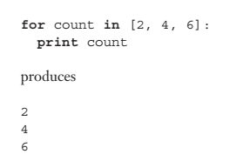
Counter-Controlled Loops: Examples
Copyright © 2017 Pearson Education, Ltd. All rights reserved.
1-<number>

Slide 27
Counter-Controlled Loops: Examples
for count in range(5):
  print(count)
  0
  1
  2
  3
  4
Copyright © 2017 Pearson Education, Ltd. All rights reserved.
1-<number>

Slide 28
Logically-Controlled Loops: Examples
C and C++ have both pretest and posttest forms, in which the control expression can be arithmetic:
while (control_expr) do
loop body loop body
while (control_expr)
- In both C and C++ it is legal to branch into the body
of a logically-controlled loop
Java is like C and C++, except the control expression must be Boolean (and the body can only be entered at the beginning -- Java has no goto
Copyright © 2017 Pearson Education, Ltd. All rights reserved.
1-<number>

Slide 29
User-Located Loop Control Mechanisms
Sometimes it is convenient for the programmers to decide a location for loop control (other than top or bottom of the loop)
Simple design for single loops (e.g., break)
Design issues for nested loops
  Should the conditional be part of the exit?
  Should control be transferable out of more than one loop?
Copyright © 2017 Pearson Education, Ltd. All rights reserved.
1-<number>

Slide 30
User-Located Loop Control Mechanisms
C , C++, Python, Ruby, and C# have unconditional unlabeled exits (break)
Java and Perl have unconditional labeled exits (break in Java, last in Perl)
C, C++, and Python have an unlabeled control statement, continue, that skips the remainder of the current iteration, but does not exit the loop
Java and Perl have labeled versions of continue
Copyright © 2017 Pearson Education, Ltd. All rights reserved.
1-<number>

Slide 31
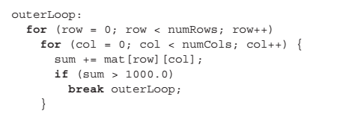
User-Located Loop Control Mechanisms
JAVA
Copyright © 2017 Pearson Education, Ltd. All rights reserved.
1-<number>

Slide 32
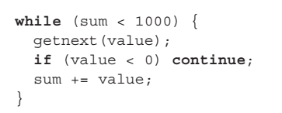
User-Located Loop Control Mechanisms
A negative value causes the assignment statement to be skipped, and control is transferred instead to the conditional at the top of the loop.
If the value is negative do not add it to the sum!
Copyright © 2017 Pearson Education, Ltd. All rights reserved.
1-<number>

Slide 33
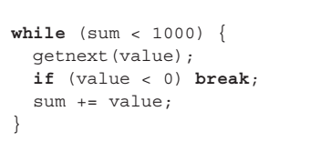
User-Located Loop Control Mechanisms
a negative value terminates the loop.
Copyright © 2017 Pearson Education, Ltd. All rights reserved.
1-<number>

Slide 34
Iteration Based on Data Structures
The number of elements in a data structure controls loop iteration
Control mechanism is a call to an iterator function that returns the next element in some chosen order, if there is one; else loop is terminated
C's for can be used to build a user-defined iterator:
for (ptr=root; ptr!=NULL; ptr=traverse(ptr)){
...
}
Copyright © 2017 Pearson Education, Ltd. All rights reserved.
1-<number>

Slide 35
Iteration Based on Data Structures (continued)
Java 5.0 (uses for, although it is called foreach)
For arrays and any other class that implements the Iterable interface, e.g., ArrayList
  for (String myElement : myList) { … }
Copyright © 2017 Pearson Education, Ltd. All rights reserved.
1-<number>

Slide 36
Iteration Based on Data Structures (continued)
C# and F# (and the other .NET languages) have
generic library classes, like Java 5.0 (for arrays,
lists, stacks, and queues). Can iterate over
these with the foreach statement. User-defined
collections can implement the IEnumerator
interface and also use foreach.
List<String> names = new List<String>();
names.Add("Bob");
names.Add("Carol");
names.Add("Ted");
foreach (String name in names)
Console.WriteLine ("Name:", name);
Copyright © 2017 Pearson Education, Ltd. All rights reserved.
1-<number>

